Slide 1
Project Ludwig
Guang Yi chua General assembly data science immersive

Slide 2
Background & Introduction

Slide 3
Music and the (Artificial) mind
What is music?
“The art of combining vocal or instrumental sounds (or both) to produce beauty of form, harmony, and expression of emotion”? (Concise Oxford Dictionary)
“Organized sound”? (Edgard Varèse, composer)
“Auditory cheesecake”? (Steven Pinker, cognitive scientist)
Interest in A.I. and music
Can a machine be creative?

Slide 4
Music and the (Artificial) mind
Questions researchers ask:
Is music necessary?
Who is music for?
Is music inherently human?
Can a machine learn to create music?
Can the music a machine composes evoke the same emotion that human music can?
Can a machine learn the compositional styles of composers and artists?
Beethoven? Bach? Chopin?
Adele? Coldplay? Taylor Swift?

Slide 5
Project Goals
Create a neural network that is capable of:
Learning to read music via musical notation
Training using music with highly flexible structures (e.g. Stravinsky, Beethoven, Gershwin)
Reproduce music in that style and output in musical notation and audio format

Slide 6
Why Ludwig?
Ludwig S.T. Meinung
L S.T. M
Meinung: Mind, soul (German)
Ludwig van Beethoven
Source: http://www.classicfm.com/composers/beethoven/guides/reasons-love-beethoven/

Slide 7
Machine Learning
One of the buzzwords at the moment
Usually also heard: deep learning, neural networks, artificial intelligence
How does it work?

Slide 8
Quick Neuroscience course
512 neurons
86,000,000,000
86 billion
Source: https://www.khanacademy.org/science/biology/human-biology/neuron-nervous-system/a/overview-of-neuron-structure-and-function
Source: http://www.everystockphoto.com/photo.php?imageId=309897

Slide 9
Classical neural network
Source: https://medium.freecodecamp.org/deep-learning-for-developers-tools-you-can-use-to-code-neural-networks-on-day-1-34c4435ae6b
Source: https://upload.wikimedia.org/wikipedia/commons/thumb/4/46/Colored_neural_network.svg/300px-Colored_neural_network.svg.png

Slide 10
Long Short term memory (LSTM)
A type of Recursive Neural Network
Source: http://colah.github.io/posts/2015-08-Understanding-LSTMs/

Slide 11
IMPLEMENTATION

Slide 12
IMPLEMENTATION
Step 1: Reading & Converting
Step 2: Training
Step 3: Prediction & Production

Slide 13
Required packages
Music21
Keras with TensorFlow backend
NumPy
Itertools
PyPlay
From Python: os, sys, copy, random, pdb
Software: MuseScore2, IDE of your choice (PyCharm, Spyder, etc.)

Slide 14
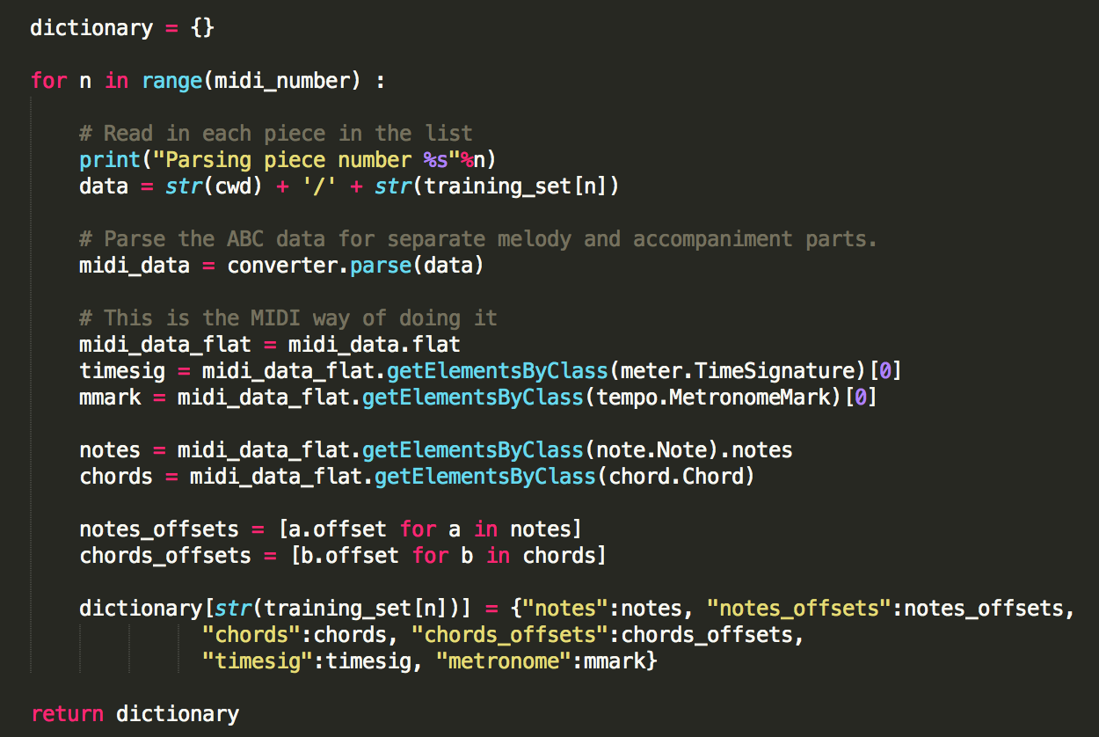
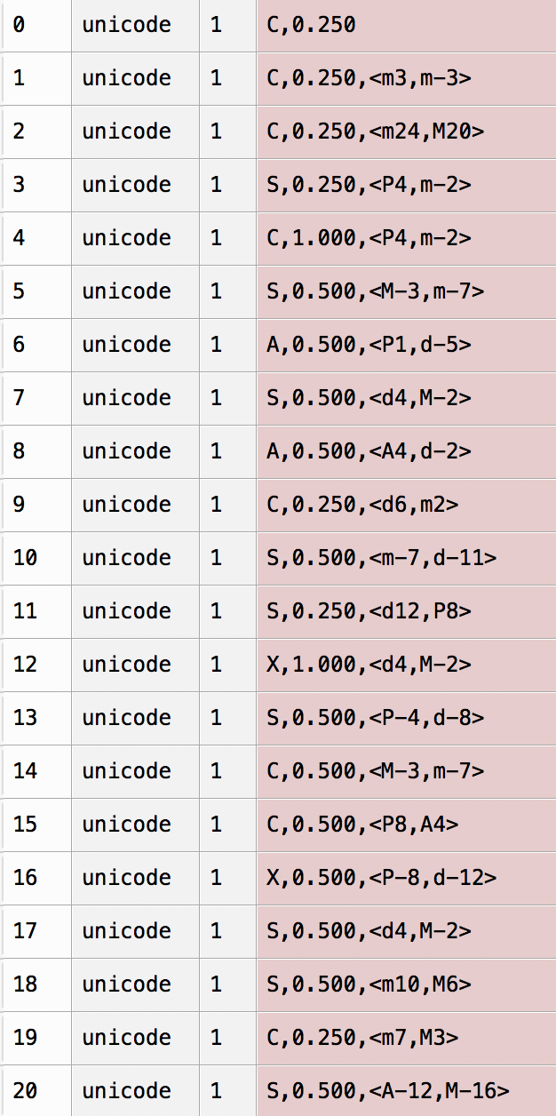

Step 1: Reading & CONVERTING
Training files: MIDI format
MIDI: Musical Instrument Digital Interface
Why MIDI?
Source: https://www.ee.columbia.edu/~dpwe/sounds/music/

Slide 15
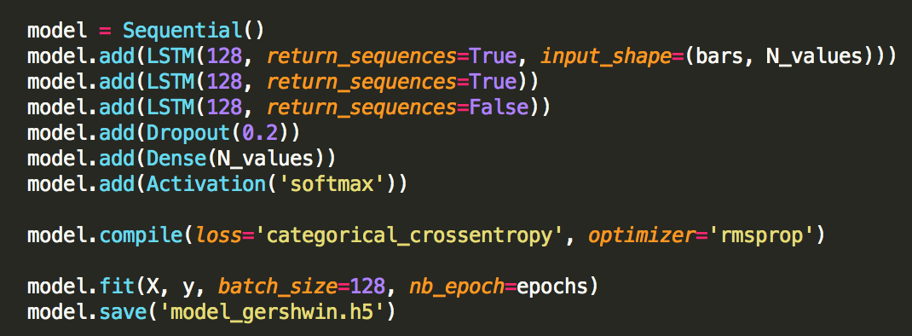
Step 2: Training
Notes:
RMS prop converges faster than the rest. Next best: Adadelta, Adagrad, then SGD
Dropout: usually used as a form of regularization
Loss function is categorical cross-entropy: Will converge more quickly without the slowdown in learning inherent in other functions
Softmax because we want the probabilities of the next pitch in the sequence to add up to 1

Slide 16
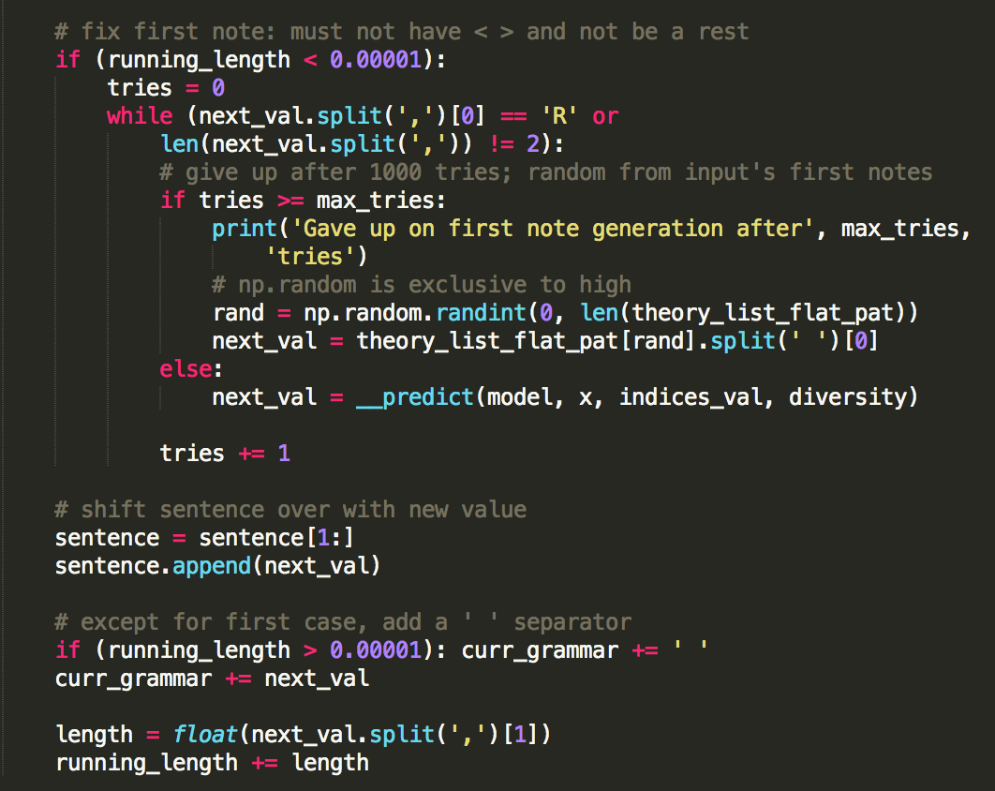
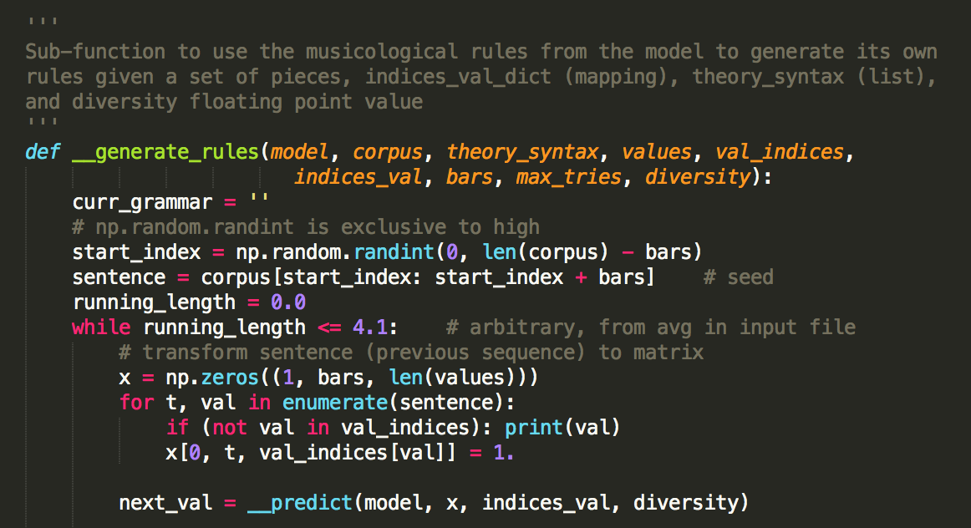
Step 3: Prediction & Production

Slide 17
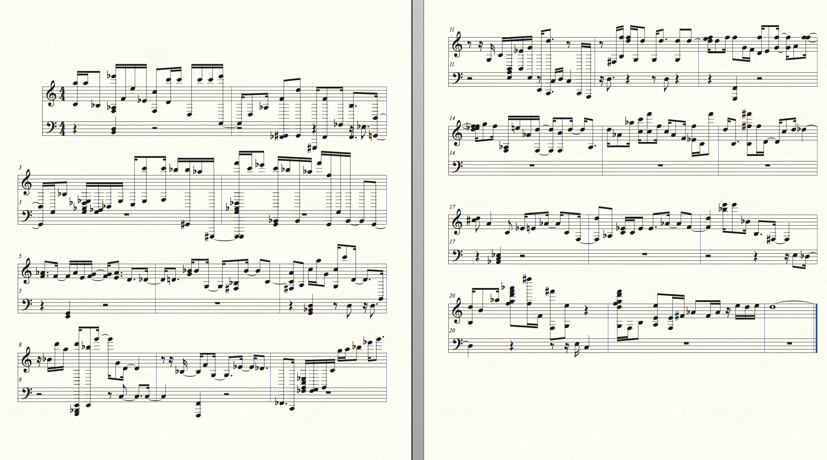
Result (Work-In-Progress)

Slide 18
Result (Work-In-Progress)
What’s good:
Input format for the model
The trained model
Currently coding to improve:
Generation rules – overall smoothness of song
Trying ideas:
Choosing only pieces with the same key
Pieces that use more than just piano

Slide 19
Thank you
Any questions?

Slide 20
Extra samples

